Slide 1
3D Geodesics

Slide 2
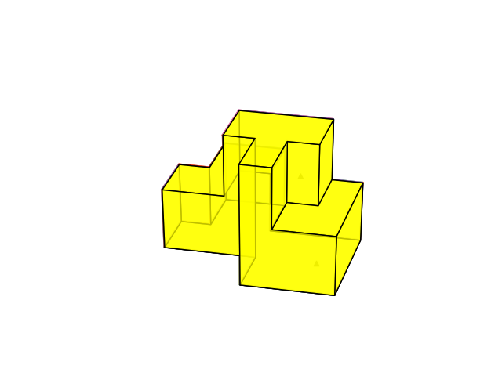
L=length of common edge
a-->c from a directly towards right to the common edge, then downwards to c
In this case, the L does not play a role.
b→ c b to common edge then along the common edge forward then down
Here, L plays role ---- [0,L]
8
9
7
15
1
2
10
12
7
8
6
14
9
d
12
1
5
3
3
4
11
2
10
13
b
13
a
11
4
6
18
5
c
14
16
17
15
d→ c : f1 → f9 → f10 → f11

Slide 3
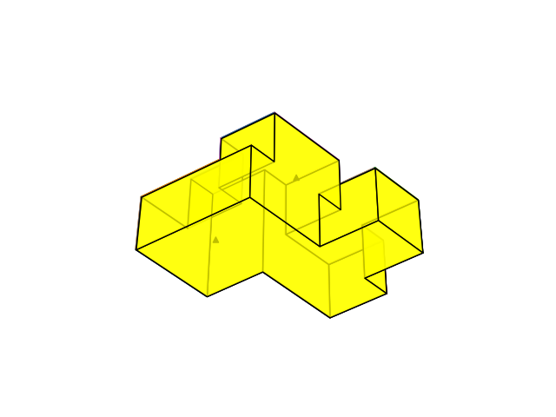
a
b
a
d
j
c
e
d
b
h
i
y
v
w
f
i
j
k
z
x
g
o
u
ad
s
m
n
ab
l
k
ac
aa
o
p
u
r
r
ae
t
af
q
q
p
t

Slide 4
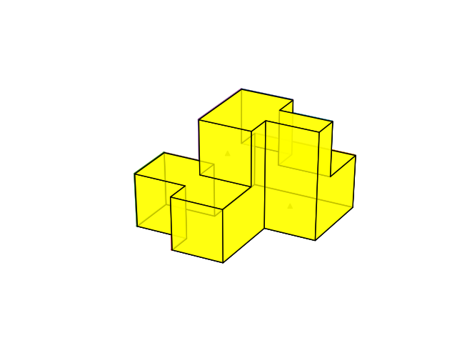
8
1
17
7
16
4
15
5
6
14
13
12

Slide 5
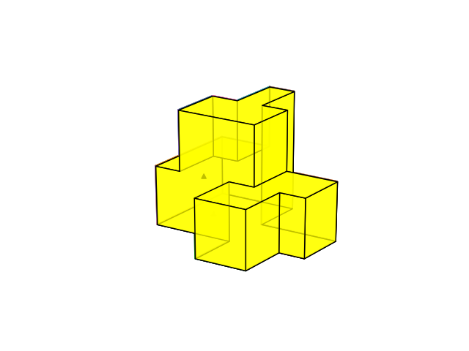
8
1
5
9
10
7
12
13
17
16
15
14

Slide 6
9
11
8
17
16
14
4
18
15
13

Slide 7
8
9
7
1
2
10
12
6
5
3
4
11
13
18
14
16
17
15

Slide 8
b
3
a
e
1
d
e
1
m
d
1
a
h
1
g
c
1
b
u
1
v
v
1
w
1
1
1
2
1
1
3
1
1
9
1
1
5
1
1
7
1
1
13
1
1
14
1
1
1
c
h
e
1
d
m
1
n
f
1
l
i
1
n
r
1
q
s
1
ad
t
1
af
af
1
ae
1
1
1
k
2
j
x
2
y
w
1
x
y
1
z
g
f
g
f
p
1
1
1
1
1
1
1
1
1
1
o
2
11
16
15
17
k
2
2
e
p
4
1
2
o
aa
2
ab
ae
1
aa
ab
1
ac
3
3
p
18
q
3
3
a
b
3
x
y
1
ab
j
1
i
1
1
q
r
i
1
1
1
1
ac
j
8
1
1
1
z
ad
v
w
12
2
2
m
1
1
ad
z
2
n
1
1
3
ae
1
o
3
ac
1
10
1
aa
u
3
s
1
k
l
t
af
3

Slide 9
8
9
7
15
1
2
10
12
7
8
6
14
9
12
1
5
3
3
4
11
2
10
13
13
11
4
6
18
5
14
16
17
15
Source Point on Face 1 and Target point on Face 18 (bottom)

Slide 10
b
3
a
Source Point on Face 1
Purple points: mid-point of all edges in a face
Connect all purple points with source point and measure the isothetic distance
This isothetic distance is the weight to the connecting face
In this way, face by face this weight assignment will proceed
BFS strategy
When target point is reached shortest path can be obtained
Later we may think of more improvement
1
1
1
1
c
h
e
1
d
1
1
g
f
1

Slide 11
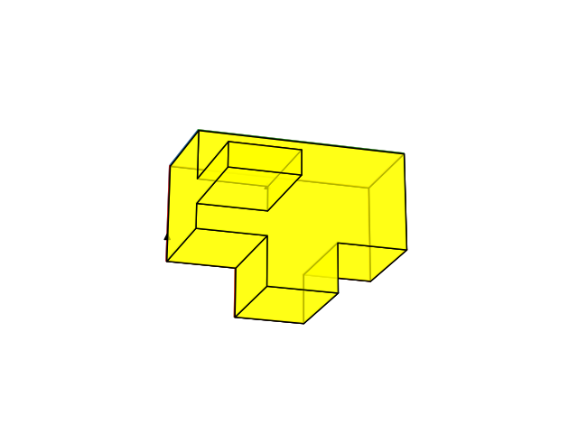
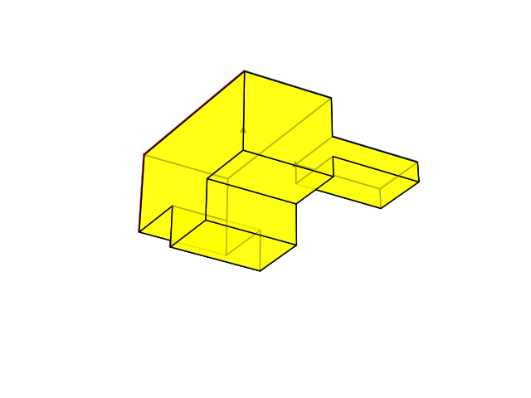

Slide 12
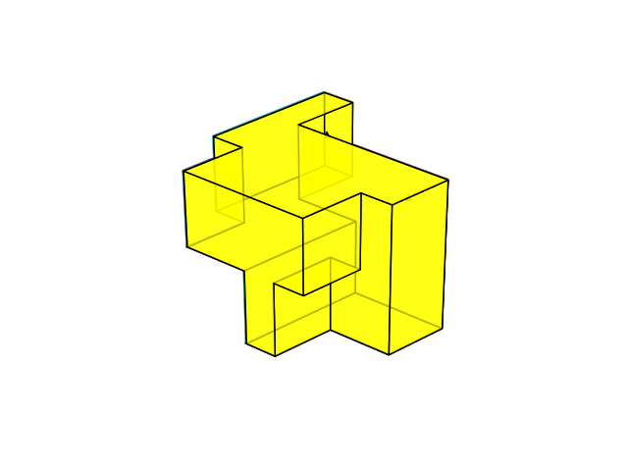
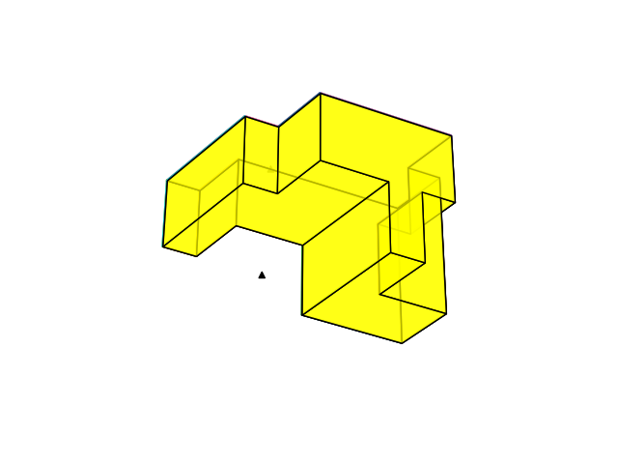

Slide 13
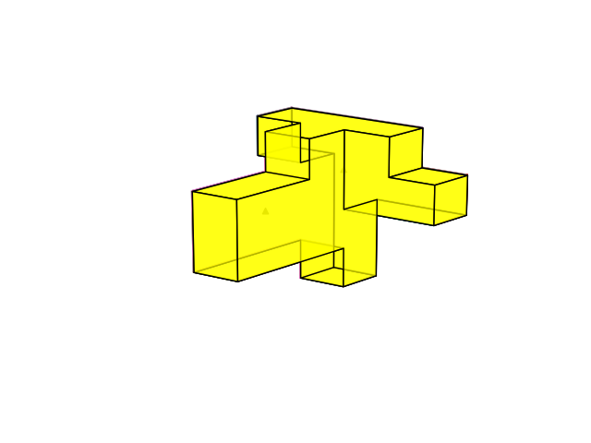
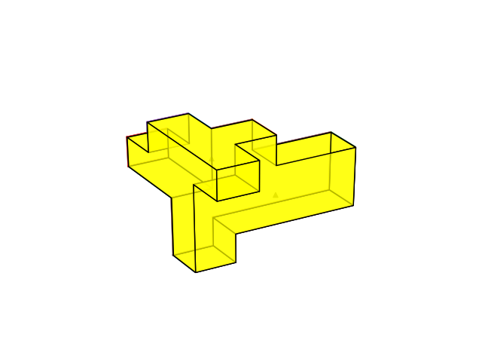

Slide 14
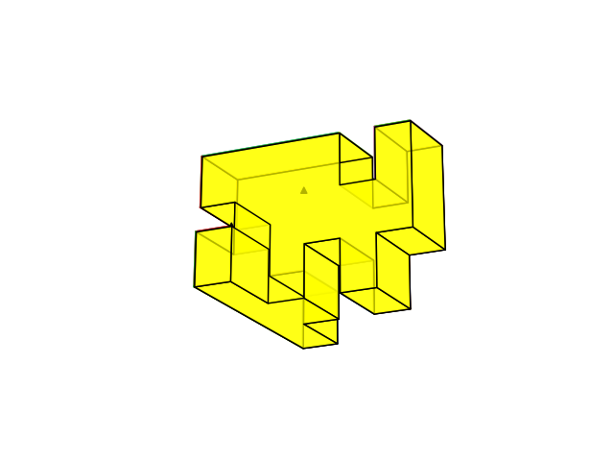
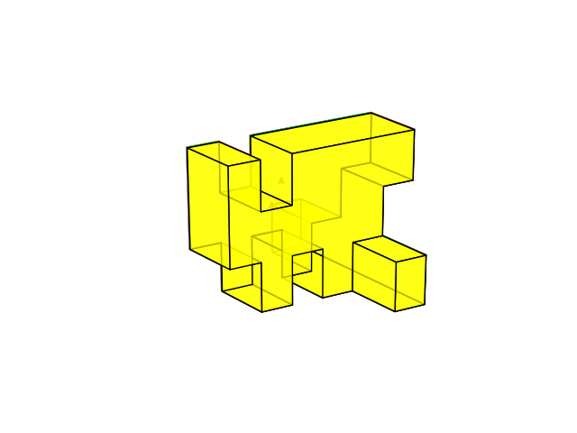

Slide 15
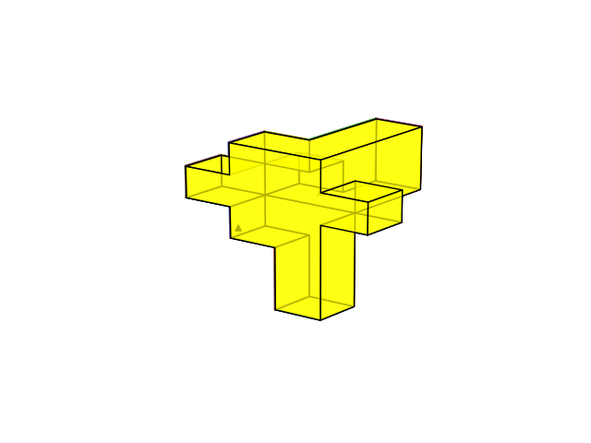
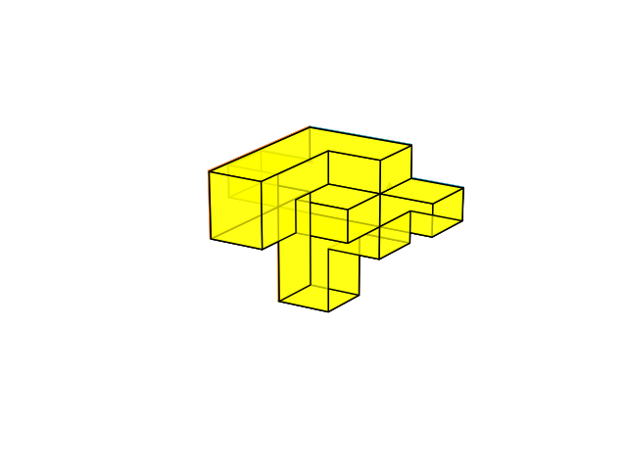

Slide 16
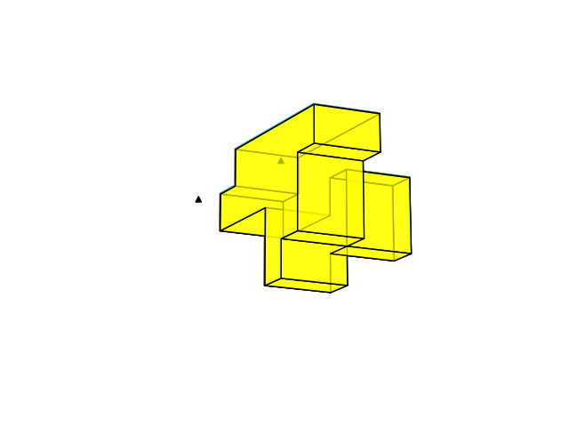
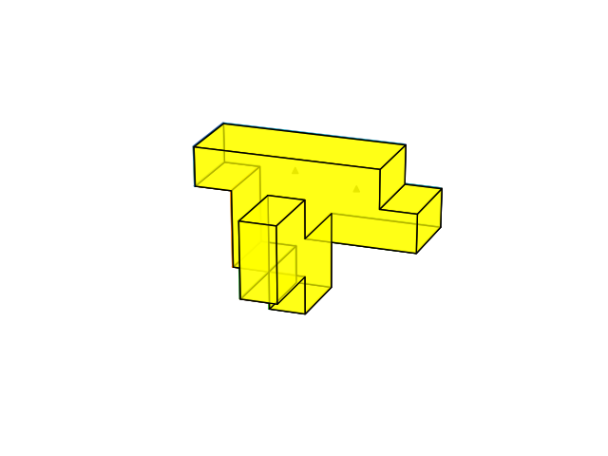

Slide 17
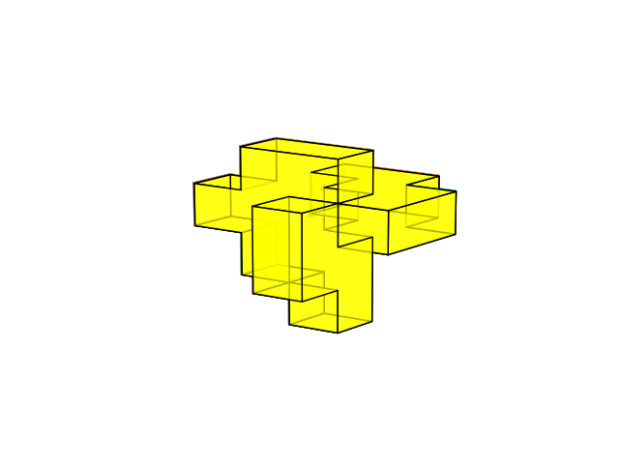
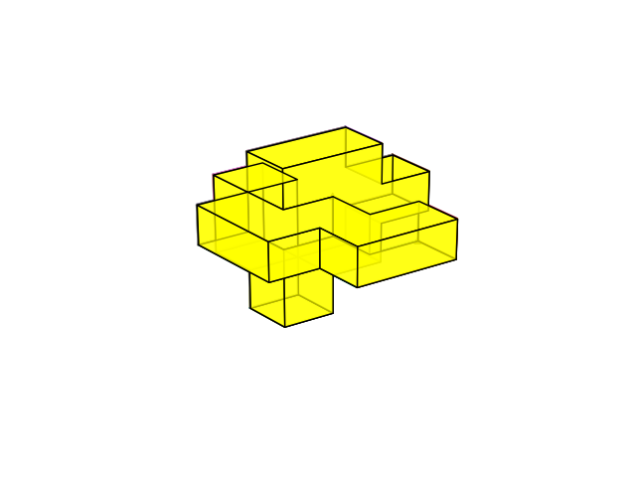

Slide 18
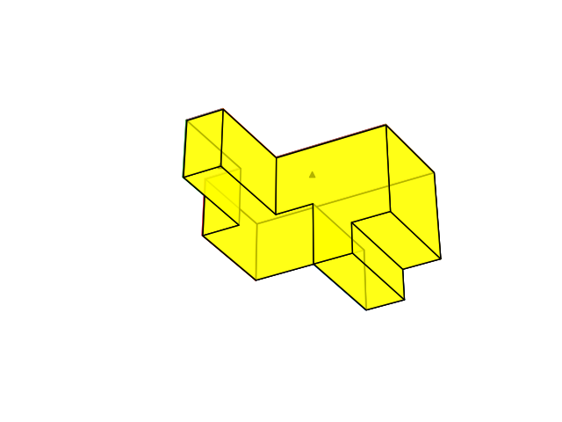
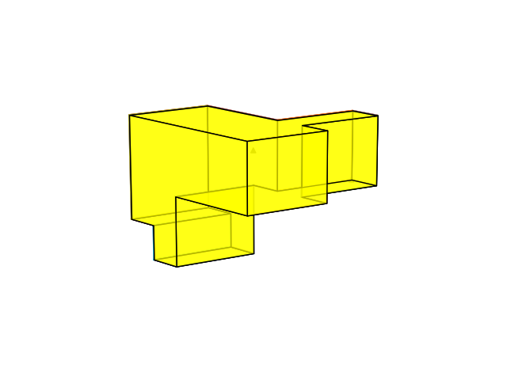

Slide 19
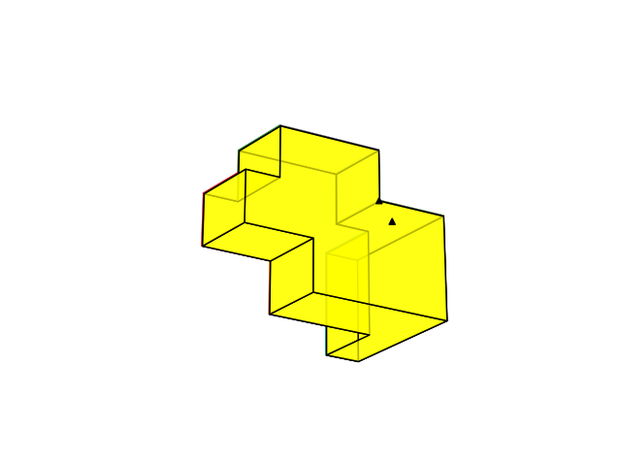
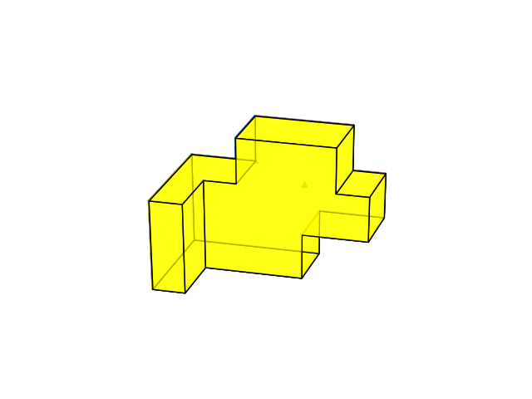

Slide 20
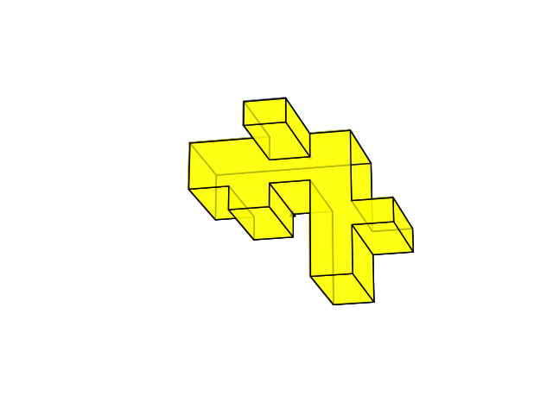
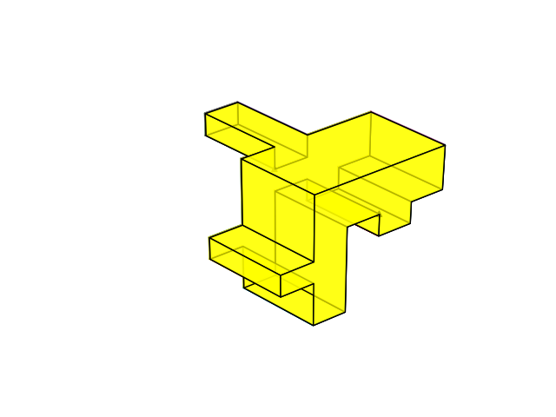

Slide 21
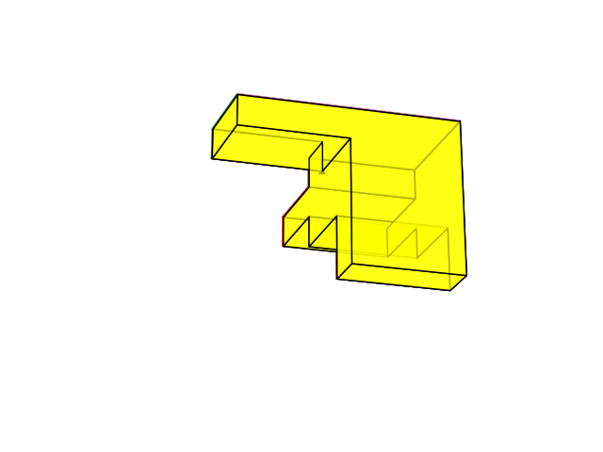
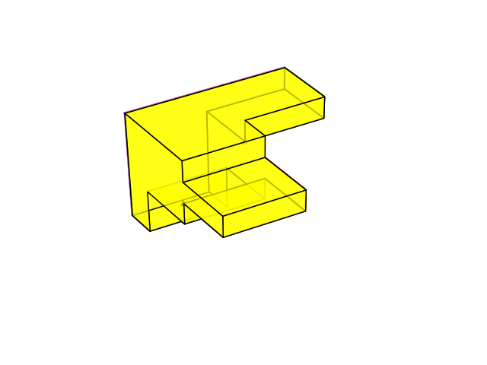

Slide 22
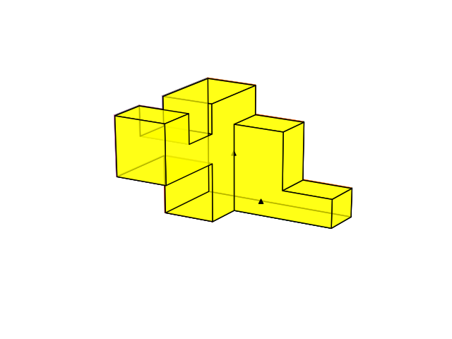
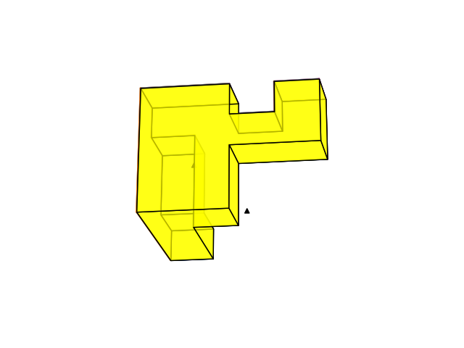
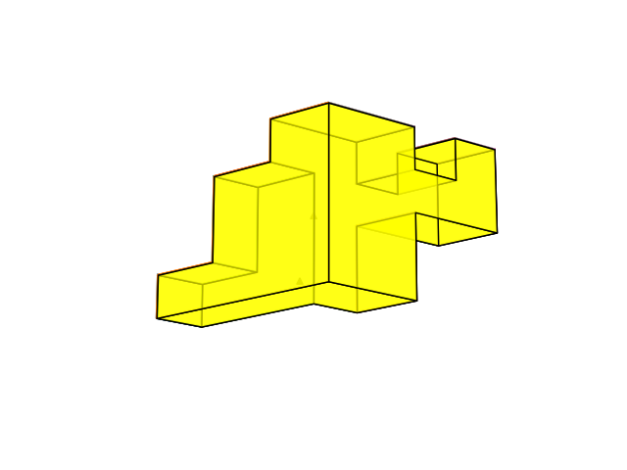

Slide 23
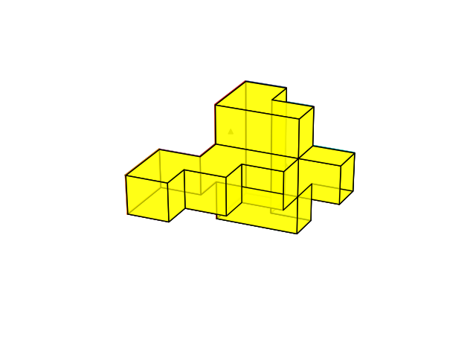
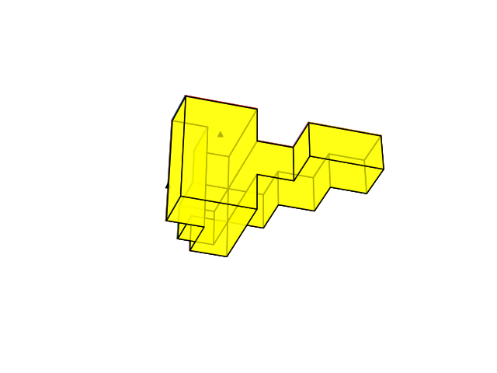
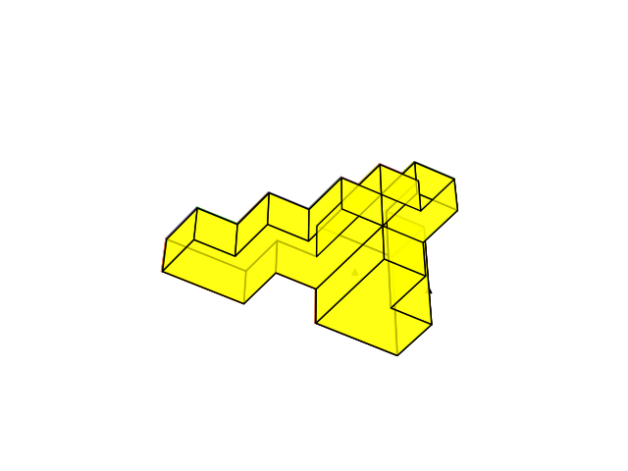

Slide 24
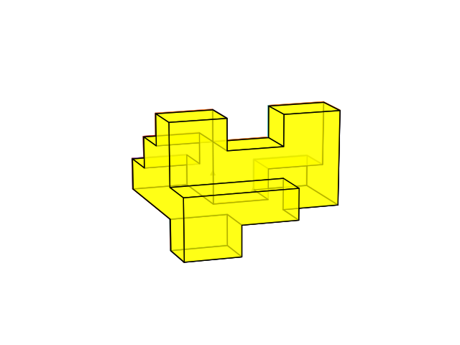
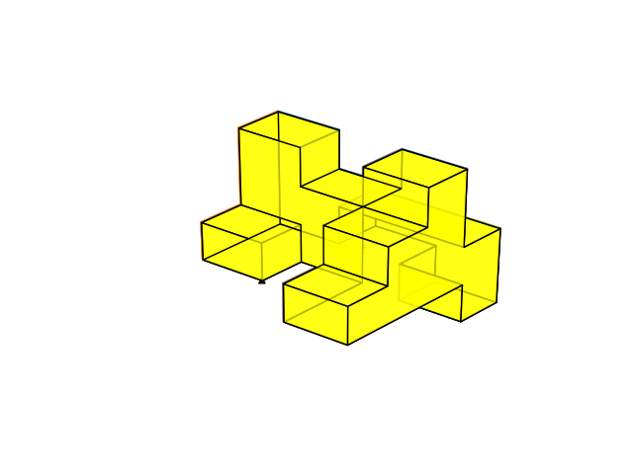
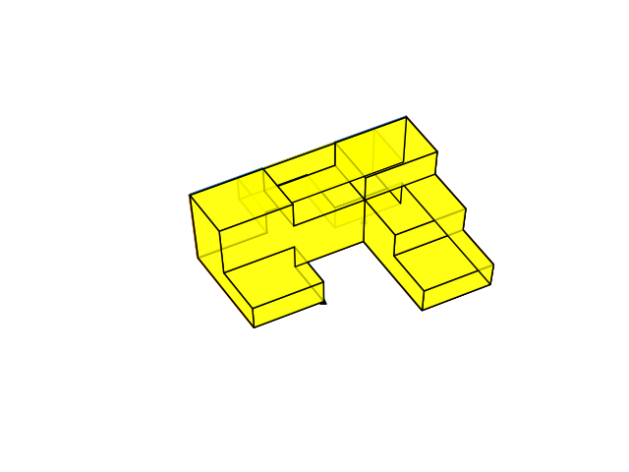

Slide 25
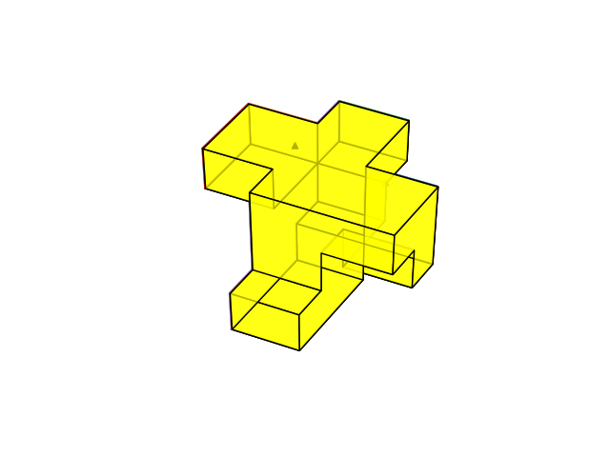
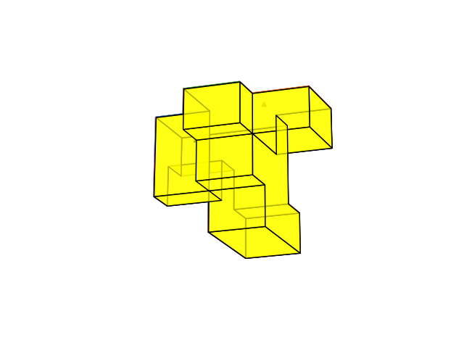
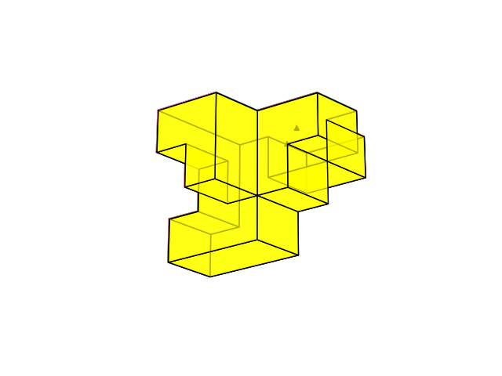

Slide 26
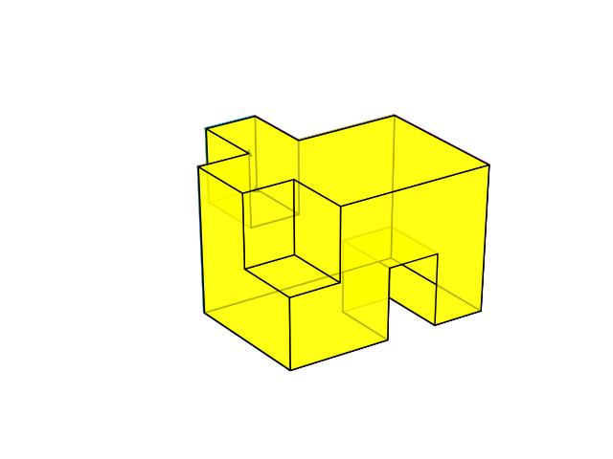
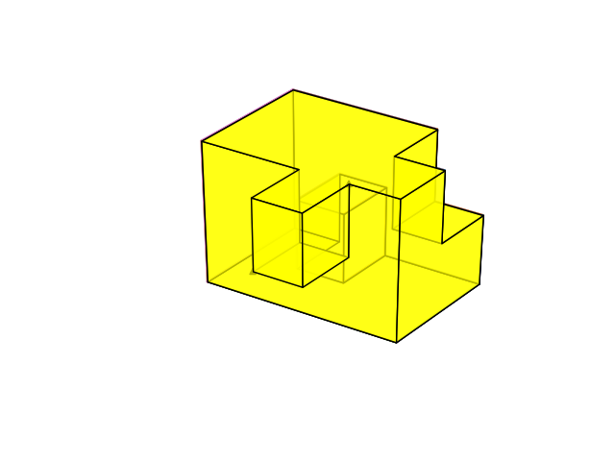

Slide 27
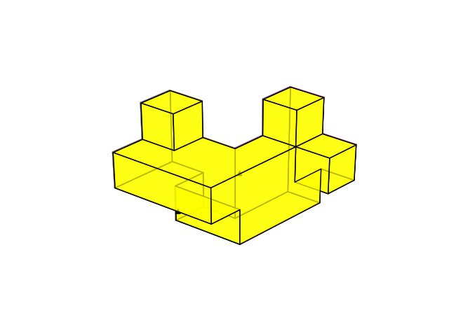
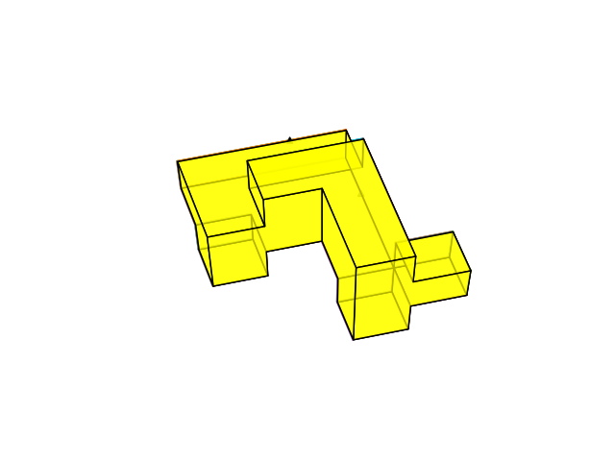
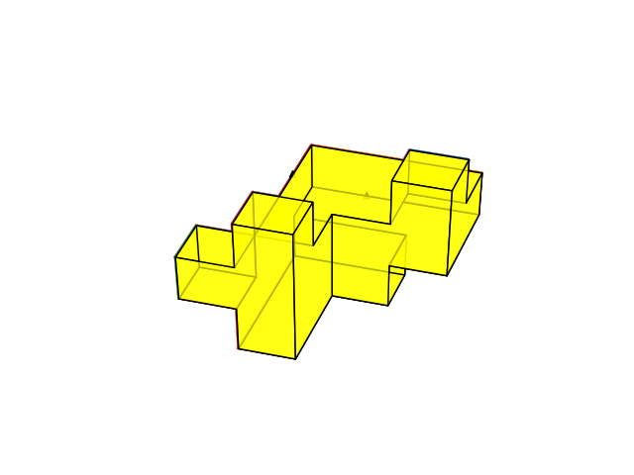

Slide 28
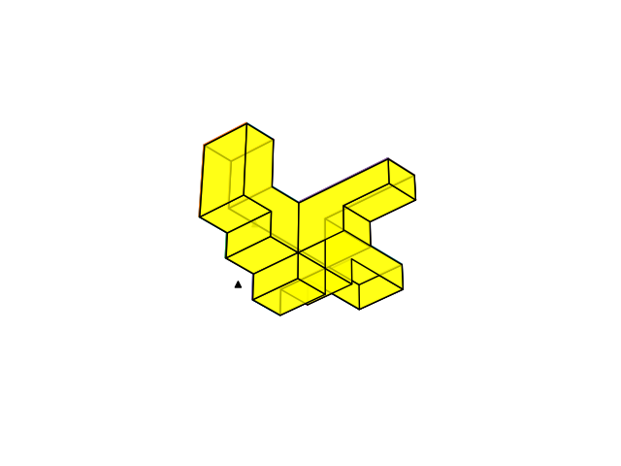
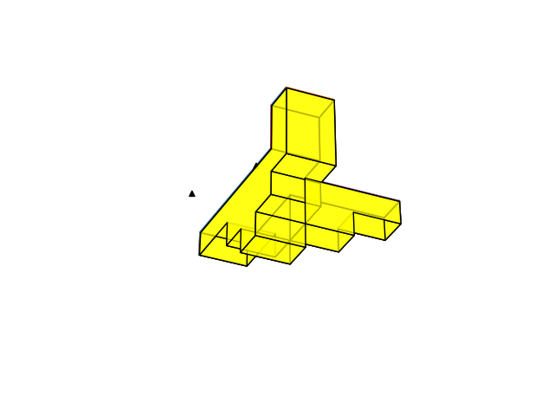
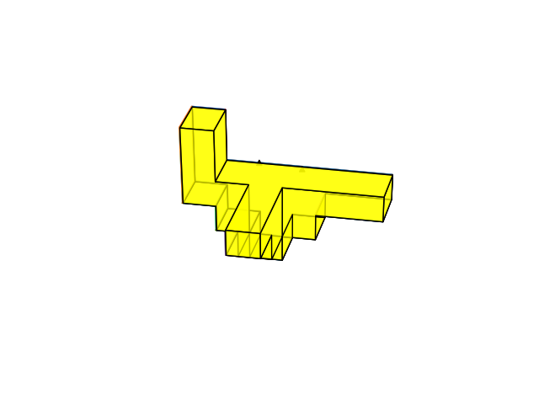

Slide 29
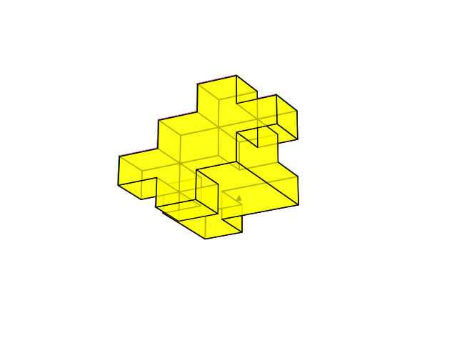
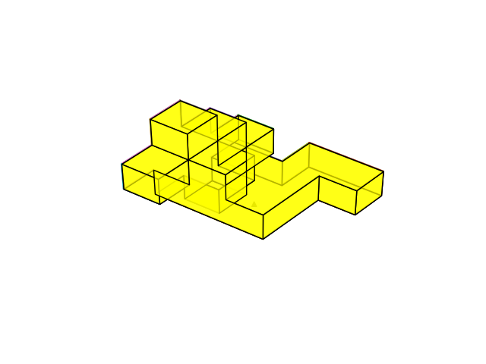
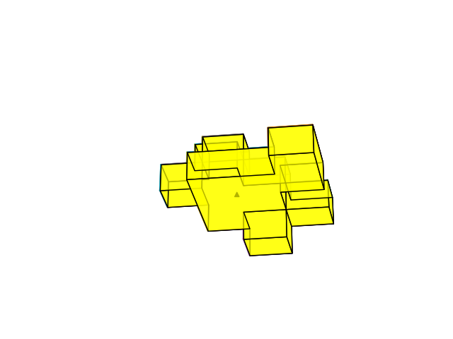

Slide 30
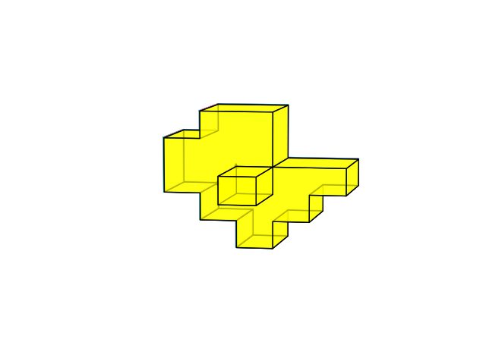



Slide 31
Path c,h,g,f,l,k,p
Edges: ch & hg - 1 common face-> no polygon for family on that face
H is concave vertex, so no family only edges
a
b
a
d
j
c
e
d
b
h
i
y
v
w
f
i
j
k
z
x
g
o
u
ad
s
m
n
ab
l
k
ac
aa
o
c
p
u
r
h
r
ae
t
e
af
q
q
p
g
f
t
l
k
p

